Slide 1

Tools & Features
Wenxuan Shi
College of Software, Nankai University
Email: shiwx@nankai.edu.cn
Wechat: 13920561100

Slide 2
Topics
Installation and setup
DevTools
Flutter SDK

Slide 3
Installation and setup
Notes:
StatelessWidget is used for immutable elements that only rely on the object configuration information
StatefulWidget is used for elements that can dynamically change based on state-changes in the system
Everytime that state changes, setChange() is called by the object

Slide 4
Installation and setup
Follow the Set up an editor instructions to install the Dart and Flutter plugins.
Updates to the plugins are shipped on a regular basis. You should be prompted in the IDE when an update is available.
To check for updates manually:
Open preferences (Android Studio > Check for Updates on macOS, Help > Check for Updates on Linux).
If dart or flutter are listed, update them.

Slide 5
Creating projects
Creating a new project
To create a new Flutter project from the Flutter starter app template:
In the IDE, click Create New Project from the Welcome window or File > New > Project from the main IDE window.
Select Flutter in the menu, and click Next.
Enter your desired Project name and Project location.
If you might publish this app, set the company domain.
Click Finish.

Slide 6
Creating a new project from existing source code
To create a new Flutter project containing existing Flutter source code files:
In the IDE, click Create New Project from the Welcome window or File > New > Project from the main IDE window.
Select Flutter in the menu, and click Next.
Under Project location enter, or browse to, the directory holding your existing Flutter source code files.
Click Finish.

Slide 7
Editing code and viewing issues
The Flutter plugin performs code analysis that enables the following:
Syntax highlighting.
Code completions based on rich type analysis.
Navigating to type declarations (Navigate > Declaration), and finding type usages (Edit > Find > Find Usages).
Viewing all current source code problems (View > Tool Windows > Dart Analysis). Any analysis issues are shown in the Dart Analysis pane:

Slide 8
Running and debugging
Running and debugging are controlled from the main toolbar:

Slide 9
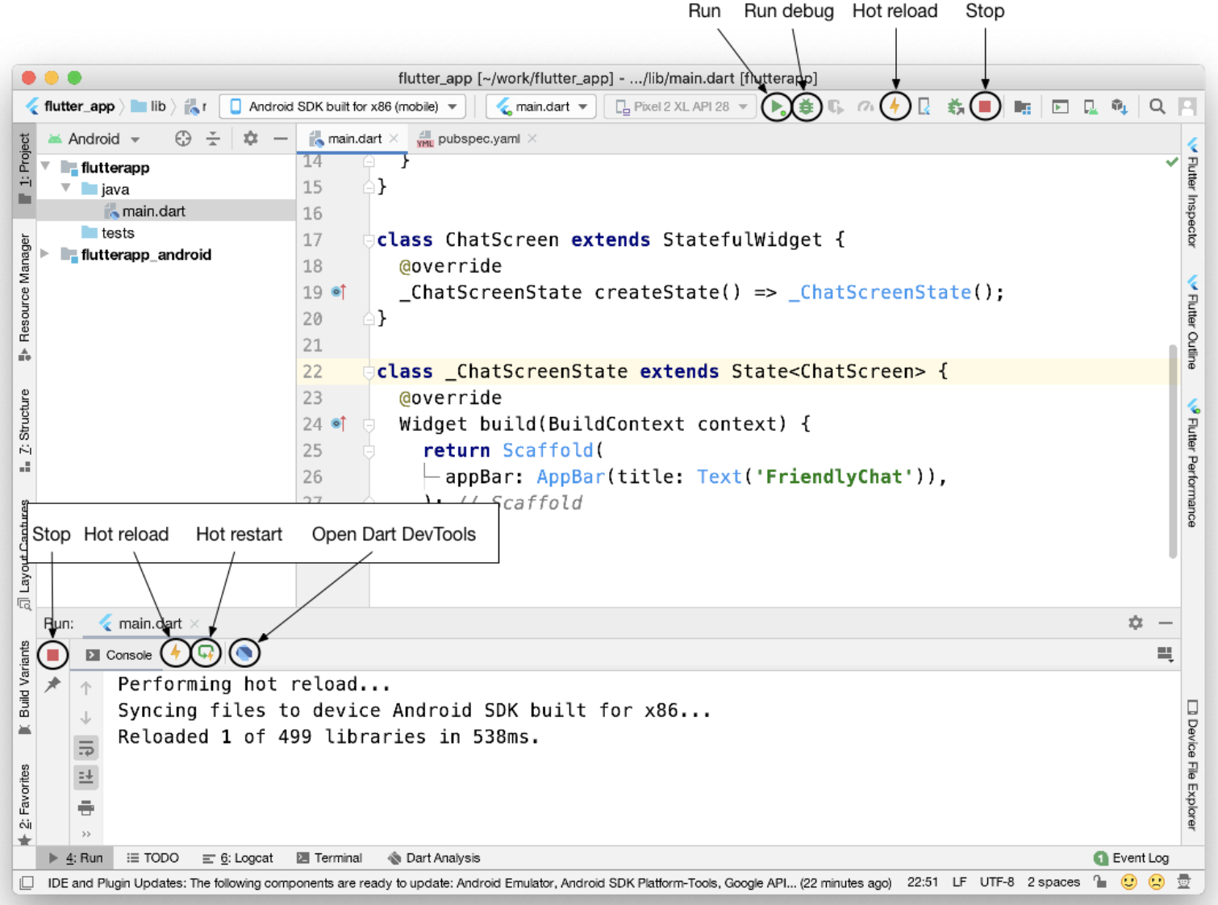
Fast edit and refresh development cycle
Flutter offers a best-in-class developer cycle enabling you to see the effect of your changes almost instantly with the Stateful Hot Reload feature.

Slide 10
Show performance data
To view the performance data, including the widget rebuild information, start the app in Debug mode, and then open the Performance tool window using View > Tool Windows > Flutter Performance.

Slide 11
Editing tips for Flutter code
Assists & quick fixes
Assists are code changes related to a certain code identifier.
The assist can be invoked by clicking the lightbulb, or by using the keyboard shortcut (Alt+Enter on Linux and Windows, Option+Return on macOS), as illustrated here:

Slide 12
Live templates
Live templates can be used to speed up entering typical code structures.
They are invoked by typing their prefix, and then selecting it in the code completion window:

Slide 13
Hot reload vs. hot restart
Hot reload works by injecting updated source code files into the running Dart VM (Virtual Machine). This includes not only adding new classes, but also adding methods and fields to existing classes, and changing existing functions.
A few types of code changes cannot be hot reloaded though:
Global variable initializers
Static field initializers
The main() method of the app

Slide 14
Hot reload vs. hot restart
For these changes you can fully restart your application, without having to end your debugging session.
To perform a hot restart, don’t click the Stop button, simply re-click the Run button (if in a run session) or Debug button (if in a debug session), or shift-click the ‘hot reload’ button.

Slide 15
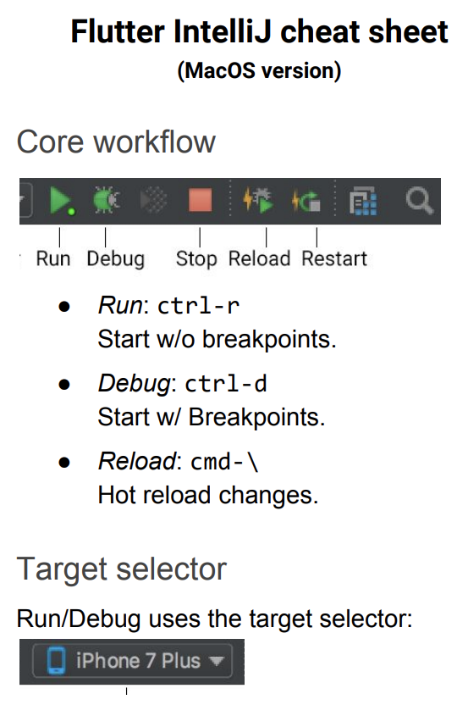
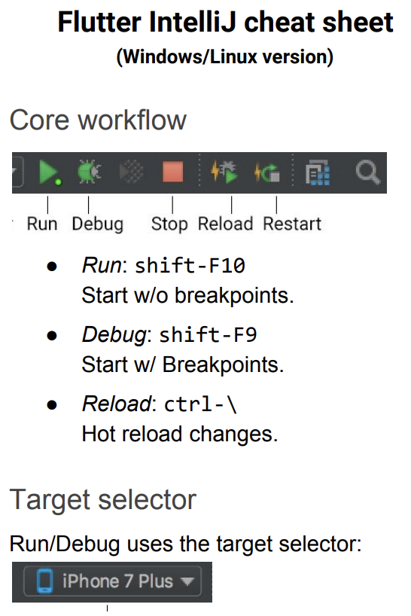
Tips and tricks

Slide 16
DevTools
Notes:
StatelessWidget is used for immutable elements that only rely on the object configuration information
StatefulWidget is used for elements that can dynamically change based on state-changes in the system
Everytime that state changes, setChange() is called by the object

Slide 17
What is DevTools?
DevTools is a suite of performance and debugging tools for Dart and Flutter.

Slide 18
What can I do with DevTools?
Inspect the UI layout and state of a Flutter app.
Diagnose UI jank performance issues in a Flutter app.
CPU profiling for a Flutter or Dart app.
Network profiling for a Flutter app.
Source-level debugging of a Flutter or Dart app.
Debug memory issues in a Flutter or Dart command-line app.
View general log and diagnostics information about a running Flutter or Dart command-line app.
Analyze code and app size.

Slide 19
How do I install DevTools?
See the Android Studio/IntelliJ, VS Code, or command line pages for installation instructions.

Slide 20
Install and run DevTools from Android Studio
Install the Flutter plugin
Install the Flutter plugin if you don’t already have it installed.
This can be done using the normal Plugins page in the IntelliJ and Android Studio settings.
Start an app to debug
To open DevTools, you first need to run a Flutter app.
This can be accomplished by opening a Flutter project, ensuring that you have a device connected, and clicking the Run or Debug toolbar buttons.

Slide 21
Launch DevTools from the toolbar/menu
Once an app is running, you can start DevTools using one of the following:
Select the Open DevTools toolbar action in the Run view.
Select the Open DevTools toolbar action in the Debug view. (if debugging)
Select the Open DevTools action from the More Actions menu in the Flutter Inspector view.

Slide 22
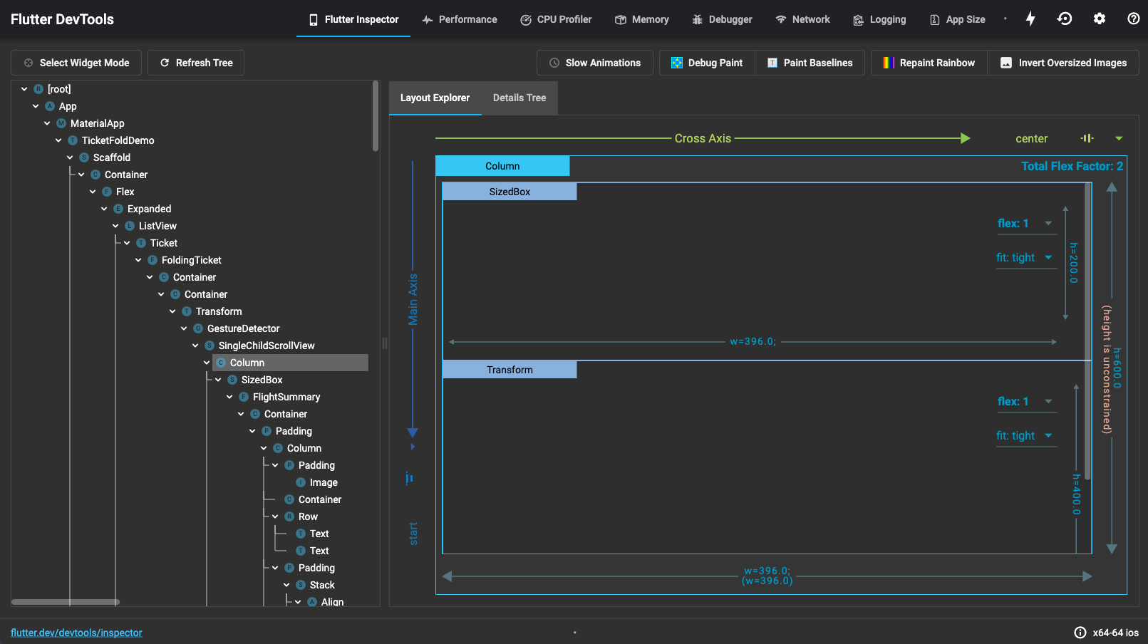
Using the Flutter inspector
The Flutter widget inspector is a powerful tool for visualizing and exploring Flutter widget trees.

Slide 23
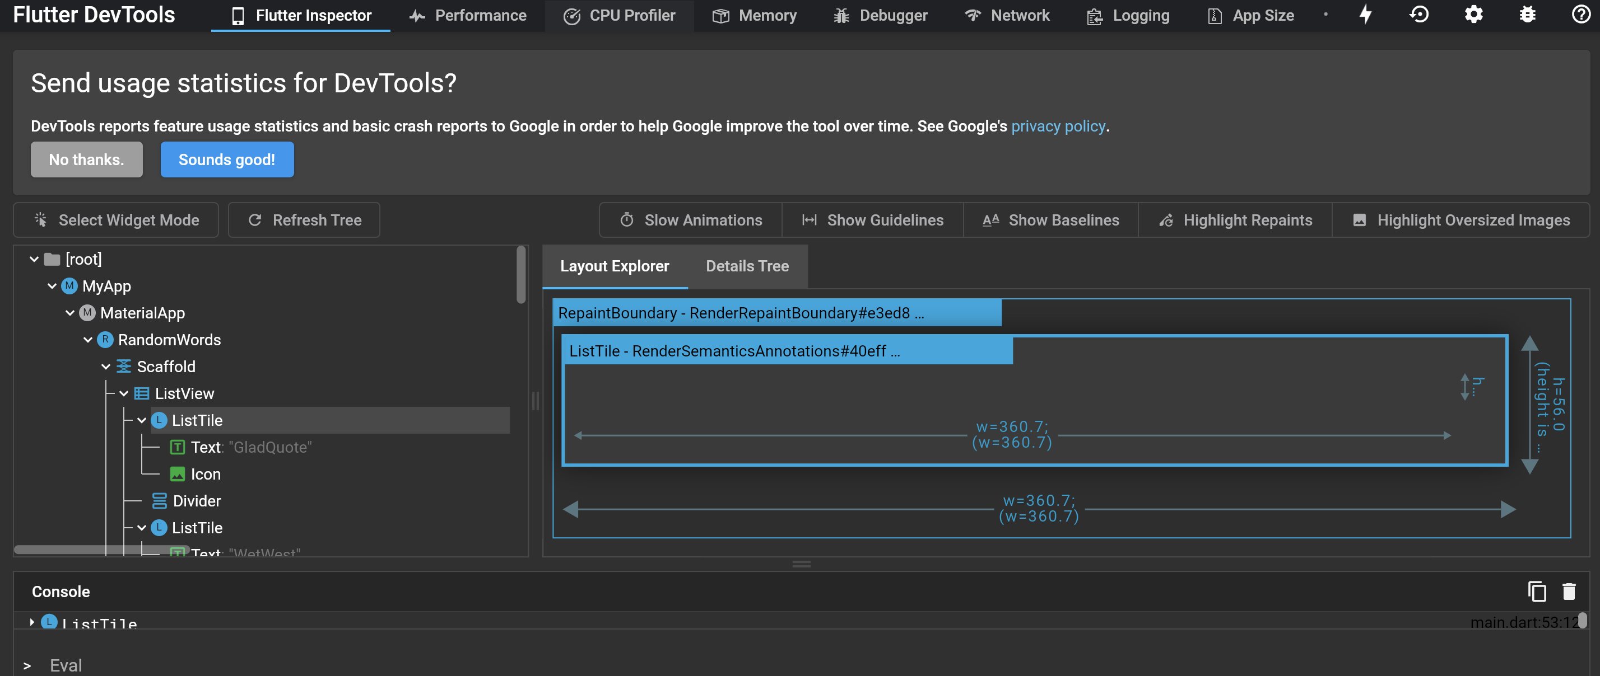
To debug a layout issue, run the app in debug mode and open the inspector by clicking the Flutter Inspector tab on the DevTools toolbar.

Slide 24
Using the Layout Explorer
From the Flutter Inspector, select a widget.
The Layout Explorer supports both flex layouts and fixed size layouts, and has specific tooling for both kinds.

Slide 25
Flex layouts: When you select a flex widget (for example, Row, Column, Flex) or a direct child of a flex widget, the flex layout tool will appear in the Layout Explorer.

Slide 26
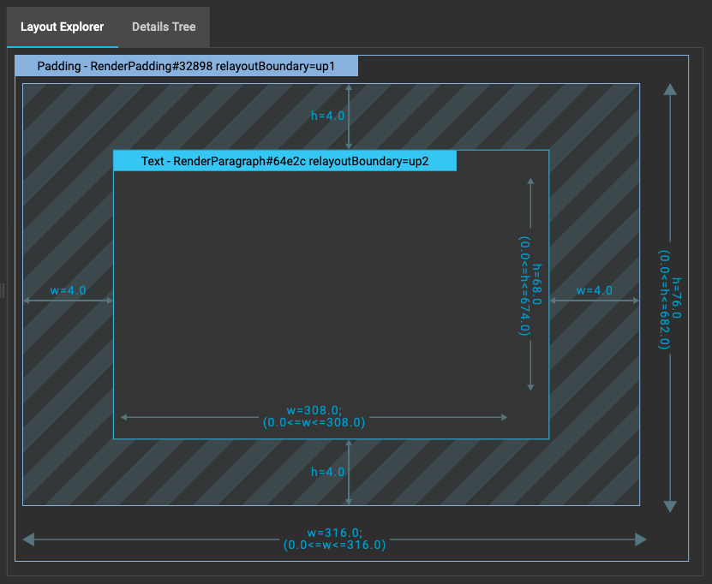
Fixed size layouts: When you select a fixed size widget that is not a child of a flex widget, fixed size layout information will appear in the Layout Explorer.

Slide 27
Flutter SDK
Notes:
StatelessWidget is used for immutable elements that only rely on the object configuration information
StatefulWidget is used for elements that can dynamically change based on state-changes in the system
Everytime that state changes, setChange() is called by the object

Slide 28
Flutter SDK overview
The Flutter SDK has the packages and command-line tools that you need to develop Flutter apps across platforms.
flutter command-line tool: The flutter CLI tool (flutter/bin/flutter) is how developers (or IDEs on behalf of developers) interact with Flutter.
dart command-line tool: The dart CLI tool is available with the Flutter SDK at flutter/bin/dart.

Slide 29
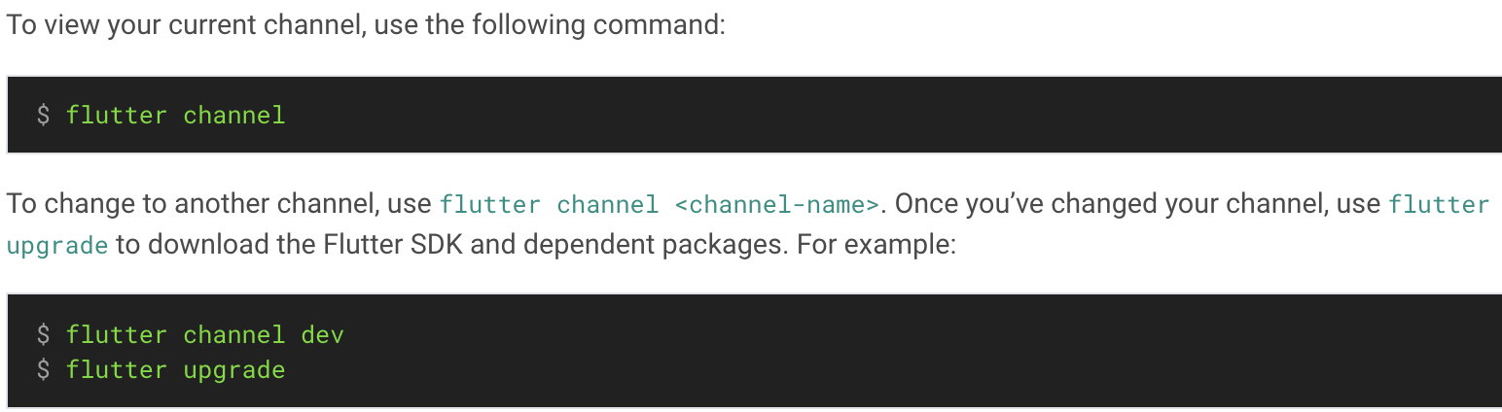
Upgrading Flutter
Upgrading the Flutter SDK
To update the Flutter SDK use the flutter upgrade command
Switching Flutter channels
Flutter has four release channels: stable, beta, dev, and master. We recommend using the stable channel unless you need a more recent release.

Slide 30
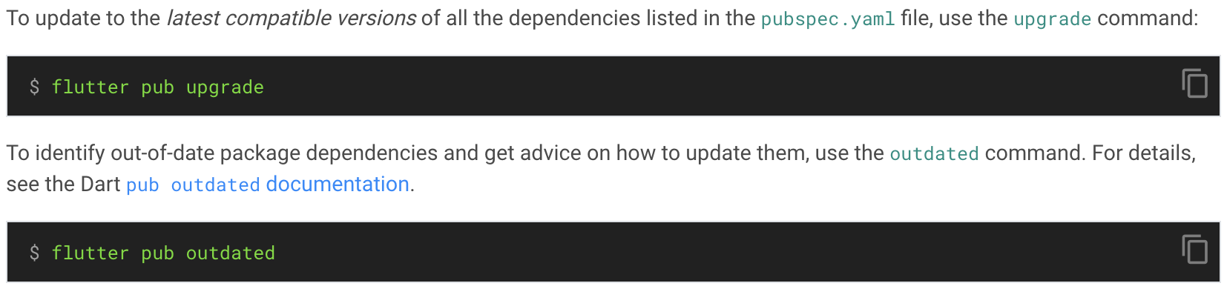
Upgrading packages
If you’ve modified your pubspec.yaml file, or you want to update only the packages that your app depends upon, then use one of the flutter pub commands.

Slide 31
Thank you!
Wenxuan Shi
College of Software, Nankai University
Email: shiwx@nankai.edu.cn
Wechat: 13920561100

